Slide 1
Adjoint Charge Deposition and CAD Transport in ITS
B. Franke, R. Kensek, H. Schriner, L. Lorence, and F. Gelbard
Sandia National Laboratories, 2001

Slide 2
Charge Deposition
Net charge deposited is the difference between the removal and absorption of charged particles in a medium
Charge removal
Interactions imparting energy to secondary charged particles
The production of secondary charged particles above the cutoff energy due to Boltzmann interactions
Charge deposited
Due to the “absorption” of charged particles slowing down in the medium
Interactions that leave the particle with less than the cutoff energy due to either the CSD operator or an inelastic Boltzmann interaction
Adjoint allows for an easier calculation of localized deposition
When electronic equilibrium exists with a photon source the charge deposition is highly localized near material interfaces
Notes:
Adjoint Weight:
Electron Absorption + weight
Electron Production - weight

Slide 3
Adjoint Particle Source for Charge Deposition
Extend MITS to charge deposition
Combination of ITS and CEPXS
Developing a proper adjoint particle source
Modifications to the cross section form
low-energy groups

Slide 4
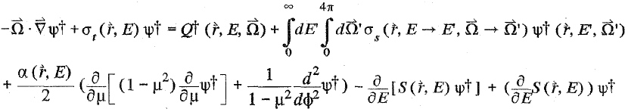
Adjoint Electron-Photon with ITS
Coupled electron-photon transport to solve Boltzmann-Fokker-Planck (BFP) equation
The adjoint BFP:
The 1st line contains the Boltzmann terms
The 2nd line contains the Fokker-Planck terms
Represent electron interactions with small deflections or energy loss
α is the restrictive momentum transfer & S is the restrictive stopping power
Notes:
Fokker-Planck Terms

Slide 5
MITS
The Multigroup/Continuous-Energy (hybrid) Integrated TIGER Series (ITS)
CEPXS/ONELD cross-section generator
ITS input/output and combinational geometry routines
Converts the multigroup-Legendre format cross sections into cumulative probability distributions for CM scattering
A particle’s group index is needed for Boltzmann scattering
A particle’s discrete energy is needed for Fokker-Planck energy loss
Notes:
Fokker-Planck Terms

Slide 6
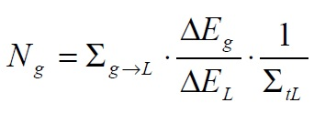
Boltzmann-Interaction Contributions to Charge Deposition
Requires accurate modeling of the lowest-energy electron group
Most positive contributions to the electron deposition, will pass through the lowest-energy group
Finite total cross-section required for adjoint
Cannot invert a non-finite cross section
Used in calculating higher energy adjoint particles
Notes:
Boltzmann inelastic cross section required for inversion
The scattering of the pseudo group is considered absorption

Slide 7
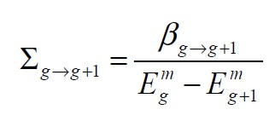
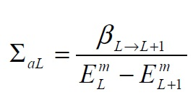
Lowest-Energy Cross-Section
Introduce a Boltzmann interaction for the lowest group
A pseudo-group is created for the lowest-energy group to “scatter” into
The Boltzmann-scattering cross section between adjoining groups
Based on the transfer of particles between adjoining groups
For the lowest group

Slide 8


Adjoint Particle Weight
Adjoint particle weight at cutoff is equal to the stopping power
When adjoint particle speeds up between groups, its weight is adjusted by the ration of stopping powers
Can use to determine the size of the pseudo-group
Adjoint particle weight in the lowest group can be defined as
Requires pseudo-group to have the same energy width as the lowest group
Notes:
Therefore the pseudo group will have a small effective absorption cross section, flux will be constant in the group, multigroup approximation holds

Slide 9
Modeling Geometries in ITS
ITS
Uses simple geometric shapes (sphere, cylinder, etc)
Combines geometries using Boolean operations
Efficient for computational run-time
Combinational geometry makes intersection calculations for ray tracing easy
All spaces is defined, even void
Enormous setup effort for complex geometries
Some objects just cannot be accurately modeled

Slide 10
Modeling Geometries
CAD
More accurate geometric representation
Faster setup time
Some models may be preexisting in CAD format
Low geometric tolerances may result in history rejection
Code can no longer follow particle trajectory if it slips into the cracks
Slower computationally
Additional face intersection calculations required for ray tracing
Not all space is well defined

Slide 11
Developing CAD routine for ITS
ACIS file format was used
Format will be automatically updated, no maintenance required
Common format for several commercial CAD packages
Routines can interrogate the geometry in the following manner:
Given a point and a direction, determine the closest boundary intersection.
Given a point, identify the region enclosing that point
Given a point on a surface, determine the outgoing surface normal
Given a point, determine the minimum distance to a boundary

Slide 12
Speeding up the CAD routine
A regular grid is superposed on the entire geometry
A list is created of all regions that intersect each cell
Entering a void only requires not being in all other regions within a cell
Create bounding volume around each part and each face
If the ray misses the bounding volume, it misses the object within
Screens rays intersecting bounding volumes
Object interrogated only if distance is closer than the closest object found
Code remembers which regions can be entered while exiting a given region
Code prevents the remaining zones from being checked more than once when determining where it is headed

Slide 13
Questions?

